Slide 1
libInterMAC: Beyond Confidentiality and Integrity in Practice
Torben B. Hansen @n_tbh
Joint work with
Martin R. Albrecht @martinralbrecht
Kenneth G. Paterson @kennyog
Information Security Group
Centre for Doctoral Training in Cyber Security
FSE 2019 March 28th

Slide 2

The next ~20 mins
Motivation
OpenSSH integration
We are here
(lib)InterMAC
Notes:
A quick outline of the next 20 mins
First, I will go over some motivation for our work
I will then introduce a library we built called libInterMAC
And, finally, how we used this library to construct new encryption schemes in OpenSSH

Slide 3
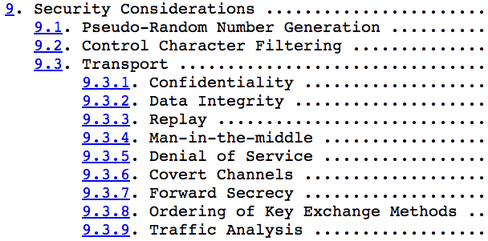
Secure Shell or SSH is a network protocol that allows data to be exchanged using a secure channel between two networked devices. Used primarily on Linux and Unix based systems to access shell accounts, SSH was designed as a replacement for TELNET and other insecure remote shells, which send information, notably passwords, in plaintext, leaving them open for interception. The encryption used by SSH provides confidentiality and integrity of data over an insecure network, such as the Internet.
– Wikipedia
RFC 4253: SSH Binary Packet Protocol
RFC 4251: SSH architecture
Consider as properties of SSH encryption schemes
Can be captured formally
Notes:
You probably all know and use SSH, a widely deployed protocol that protects large amounts of traffic.
The SSH transport layer protocol, named the Binary Packet Protocol, specifies the SSH packet format and the cryptographic processing performed on them, using various encryption schemes.
The Binary Packet Protocol provides the fundamental security guarantees of SSH: confidentiality and integrity of data.
However, SSH also aims at providing security properties that go beyond the fundamentals. Some of these security properties are mentioned in RFC 4251 – which specifies the overall architecture of SSH.
We will focus on two of these:
Denial-of-Service
And
Traffic analysis
We will investigate these as properties of SSH encryption schemes.
In this context, we can formally define what security against traffic analysis and denial-of-service means.

Slide 4




Symmetric encryption schemes supporting ciphertext fragmentation
[BDPS12]
C₁
C
M₁ ← Dec_{k}(C₁)
ciphertext fragmentation
C ← Enc_{k}(M)
C₂
M₂ ← Dec_{k}(C₂)
M
by Giorgia Marson
Notes:
To formally define these security properties, we will use a setting by Boldyreva, Degabriele, Paterson and Stam.
They introduced the notion of symmetric encryption schemes supporting ciphertext fragmentation.
Lets say Alice produces a ciphertext C and sends it over the network to Bob.
The standard assumption is that the ciphertext arrives to Bob in its entirety.
However, in the real world, due to the nature of networks, the ciphertext might arrive to Bob in fragments, we call these fragments for ciphertext fragments.
Bob must somehow decrypt these ciphertext fragments, and still arrive at the underlying message in the end.
BDPS calls this network induced fragmentation for ciphertext fragmentation and defines a setting that captures the mechanics of it.
Note that the ciphertext fragments arriving to bob might contain partial ciphertext, several ciphertexts or a combination.
Ciphertext fragmentation is a feature that must be supported by real-world protocols.
For example, SSH supports it through its use of a length field in its packets.

Slide 5
Security properties
[BDPS12]
[ADHP16]
Traffic
Analysis
Confidentiality /
Integrity
Boundary
Hiding
DoS
Active
Passive
C =
DJ@)%&6h
C₁
C₂
C’ =
*s&FQOm”F
C₃
DJ@)%&6h*s&FQOm”F
C
C’
Notes:
BDPS together with Albrecht, Degabriele, myself and Paterson, defines a number of security notions for symmetric encryption schemes supporting ciphertext fragmentation.
There are the fundamental notions of confidentiality and integrity.
But also two notions that go beyond these. Namely:
A boundary hiding notion.
And a DoS notion.
It is these two notions that capture the traffic analysis and denial-of-service security goals of SSH.
The boundary hiding notion captures the traffic analysis security goal.
A scheme satisfying this notion prevents an adversary from learning ciphertext boundaries in a concatenated sequence of ciphertexts. That is:
If Alice sends two equal-length ciphertexts.
The adversary gets access to the concatenation of these.
It is then the adversaries task to delineate this string of data into the original ciphertexts. There is both a passive and an active version of this notion.
In the passive case the adversary has access to the encryption algorithm.
While in the active case, the adversary also has access to the decryption algorithm. (This makes for a very powerful adversary and a strong notion.)

Slide 6
Security properties
[BDPS12]
[ADHP16]
Traffic
Analysis
Denial-of-
Service
Confidentiality /
Integrity
Boundary
Hiding
DoS
ƛ
I’m back
C₁
C₂
LENGTH(C₁ || C₂ || ∙∙∙ ) > ƛ
∙∙∙
Notes:
The DoS notion captures the Denial-of-Service security goal (surprise) and is parameterised by a parameter: lambda.
The DoS property ensures that the adversary cannot make Bob hang for more than a lambda amount of ciphertext.
That is, the lower the lambda the better Bob is to detect denial-of-service attacks and the faster he can respond to them.
(SSH is trivially susceptible to this kind of attacks for several of its supported encryption schemes because the length field contained in SSH packets are not authenticated before processing the packet.)

Slide 7
Not generically secure
Can’t utilise AES intrinsics
[APW09]
[ADHP16]
Boundary Hiding
SSH encryption:
Passive Active
DoS
Encrypt-then-MAC
NO
NO
NO
AES-GCM
NO
NO
NO
ChaCha20-Poly1305
YES
NO
NO
Encrypt-and-MAC
YES
NO
NO
None of the current SSH encryption schemes adequately provides the desired security properties
Can these security properties be realised simultaneously in SSH?
At what cost?
Notes:
SSH supports a number of different encryption schemes to encrypt packets.
These names define encryption schemes that does more than raw encryption such as encoding and processing of SSH packets, but we won’t go into the finer details.
The two different encrypt-mac schemes are either instantiated with AES in counter mode or AES in CBC mode and use HMAC as the MAC algorithm.
ADHP evaluated all these schemes according to the security notions we have just seen.
And it turns out that almost all of these schemes fall short of meeting the desired security notions.
In fact, only chacha-poly and encrypt-and-mac provides passive boundary hiding. On the other hand, these two methods has some noticeable drawbacks.
Chacha-poly can’t utilise AES intrinsics, which makes it a rather slow choice.
Encrypt-and-mac, is not generically secure, which is shown by ADHP and also by Albrecht, Paterson and Watson in 2009.
We can see that none of the currently supported encryption schemes in SSH adequately provides the desired security properties. Two natural questions to ask are then:
Can these security properties be realised and can they be realised simultanously?
And at what cost?

Slide 8
InterMAC
[BDPS12]
Achieves BH and DoS
N
N
N
0
0
1
Enc
Enc
Enc
Chunk counter:
Message counter:
0
Mac
1
Mac
2
Mac
c
c
c
Decryption
Notes:
We can answer that first questions positively. Our starting point is the scheme InterMAC.
The scheme is constructed as follows:
Given a message
first split the message into equal-sized chunks of length N, counting in bytes.
Encode each chunk with a chunk delimiter, which is a 0-byte for each chunk
except the last chunk that gets a 1-byte appended.
Encrypt each encoded chunk.
Compute the MAC over each ciphertext chunk and append the resulting MAC tag to the end of the corresponding ciphertext
The MAC must also encode a chunk counter and message counter
The chunk counter is incremented for each chunk and reset for each message while the
The message counter is incremented for each message
Finally append all ciphertexts and MAC tags to produce the final ciphertext.
Decryption is done chunk-wise by verifying the MAC tag, decrypting and checking whether the encoded chunk has a 1-byte appended. If the 1-byte is observed, the plaintext is recovered.
This scheme was defined in [BDPS] and satisfy confidentiality and integrity but also it also satisfy boundary hiding and DoS.
For kicks, we can have a short look at the boundary hiding and DOS proof intuition. When the encryption scheme is IND$-CPA and the MAC is a PRF the resulting pair of ciphertext and MAC tag looks like random bytes. The concatenation should also look like random bytes. Hence the attacker will have a hard time telling ciphertext boundaries apart. Also, DOS protection is secured up to approximately the chunk length, which can be much smaller than the maximal packet size.
InterMAC provides the security properties we are interested in.
In addition, BDPS also claims that it can be used with ”low overhead” in practic, which would be great. However, as we will se soon it is not so simple.
Before we attempt to implement InterMAC, we first do a series of modifications to InterMAC.
First of all, it turns out the the authors of InterMAC somewhat cheated a bit.

Slide 9
InterMAC in practice
0x0
0x1
0x1
0x1
N
N
N
t=1 : no padding
t=2 : padding
0
0
1
1
t
Enc
Enc
Enc
Chunk counter:
Message counter:
0
Mac
1
Mac
2
Mac
c
c
c
Notes:
Because the scheme does not support messages of arbitrary length.
The fix is simple, we just apply padding.
The padding it is very simple:
If the last byte is zero, pad with1’s.
If the last byte is not zero, pad with 0’s.
As an optimisation, we can modify the chunk delimiter to indicate if any padding is applied. Doing this we save a whole chunk of padding if the message aligns on the chunk length.

Slide 10
InterMAC in practice
0x0
0x1
0x1
0x1
N
N
N
t=1 : no padding
t=2 : padding
0
0
t
Chunk counter:
Message counter:
0
Enc
1
Enc
2
Enc
c
c
c
Nonce-based
AE
We prove “InterMAC in practice” achieves BH and DoS
Notes:
In addition, and as mostly a syntactic change, we introduce nonce-based AE schemes as the internal encryption function instead of doing encryption and MAC’ing separately.
With this change one needs to be conscious about how the chunk counter and message counter are incorporated with the AE scheme.
We will construct the Nonce from the chunk counter and message counter
The changes made to the original InterMAC scheme does not affect the security i.e. the modified scheme still meets all security notions: confidentiality, integrity, boundary hiding and DoS.
We then implemented InterMAC with these changes applied to the scheme.

Slide 11
libInterMAC
C-implementation
Small API
User-oblivious nonce-management
Algorithm agility
AES-GCM
ChaCha20-Poly1305
We implemented counter measures against attack vectors that goes beyond the formal model
Notes:
We call the implementation for libInterMAC.
The library is written in C and we make some efforts to make it hard for users to make mistakes that might compromise security.
Two of the affords we have made are the following:
Firstly, we have tried to minimise the API, and simple to use.
Secondly, the library handles nonces for the nonce-based AE schemes and it is not possible for a user to set or nonces.
Another feature we added is agility with respect to the internal AE scheme. Currently, we have code to support AES-GCM and ChaCha20-Poly1305 – not to be confused with the SSH encryption schemes with the same name!
A last point I will mention is that we made some effort to identify attack vectors that goes beyond the formal model and attempted to implement counter measures against these.
One of these are attackers that use timing channels to break boundary hiding.
I will go into a bit more detail about this.

Slide 12
Constant-time decryption
We implemented counter measures against attack vectors that goes beyond the formal model
Response time from decryption algorithm is ciphertext boundary dependent
Can we ensure that the execution time of the decryption algorithm is independent of the ciphertext boundaries?
C =
DJ@)%&6h
C₁
C₂
C’ =
*s&FQOm”F
C₃
DJ@)%&6h*s&FQOm”F
C
C’
Notes:
Recall that in boundary hiding, the adversary must delineate ciphertext boundaries in a sequnece of ciphertexts. This might be possible by measuring response times from the decryption algorithm.
To prevent this, we must ensure that the execution time of the decryption algorithm is independent of ciphertext boundaries.

Slide 13
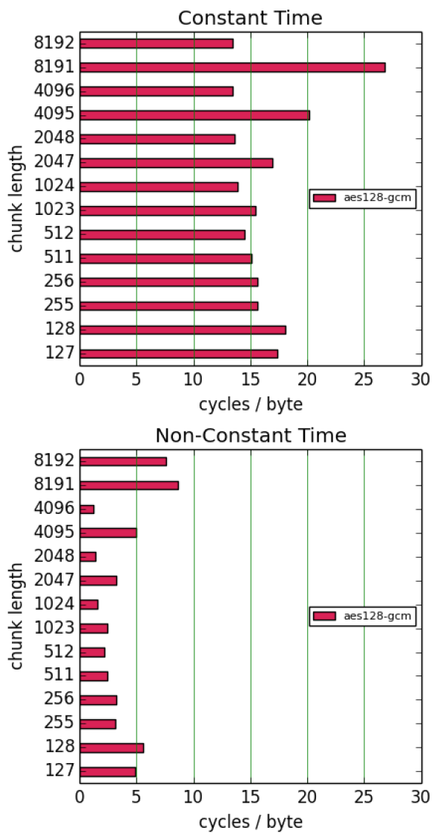
Padding removal
N
N
N
Constant-time removal
Search through the whole chunk
Invoked on all chunks
Constant-time: 4-5× slower
libInterMAC implements the constant-time version
Notes:
One thing that leads to non-uniform response time is removal of padding.
To prevent this we have implement a constant-time padding removal.
Firstly, we search through the whole chunk and don’t just stop when we have found the padding length
Secondly, we do this on all chunks.
Obviously, having to do a linear search through all chunks, separate from decryption, is costly.
To quantify this cost, we have run an experiment, were we decrypt an 8KB message with and without constant-time padding removal.
The results are that, constant-time padding removal is about 4-5 times slower depending on the chunk length. Which is quite a bit slower.
However, we have decided to implement the constant-time padding in libInterMAC because we value the added security more and we wanted to get a truthful representation of what it takes to implement InterMAC properly.
We also identified other sources of timing signals and implemented counter measures against them.

Slide 14
Constant-time decryption
We implemented counter measures against attack vectors that goes beyond the formal model
Response time from decryption algorithm is ciphertext boundary dependent
Can we ensure that the execution time of the decryption algorithm is independent of the ciphertext boundaries?
Identified additional timing channels and implemented counter measures
We tried to limit the scope for mounting attacks exploiting timing signals
We do not achieve full constant-time decryption
Interesting open problems in this area
Notes:
We have also identified other possible channels of timing signals and implemented counter measures against some of these.
However, there are still some branching in the code that does not make timings fully uniform.
In fact, we think there are some interesting open problems in this area and I encourage you to read the paper to learn more.

Slide 15
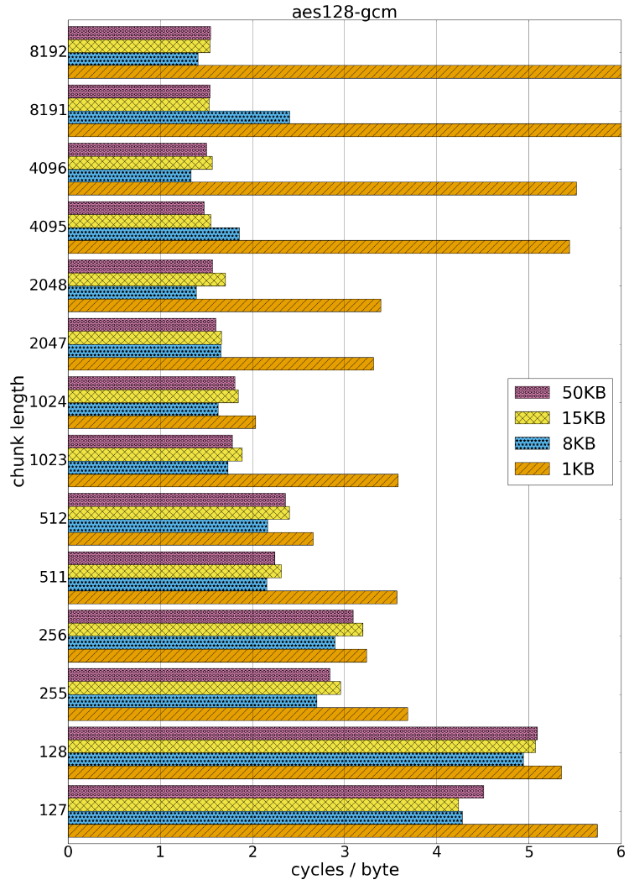
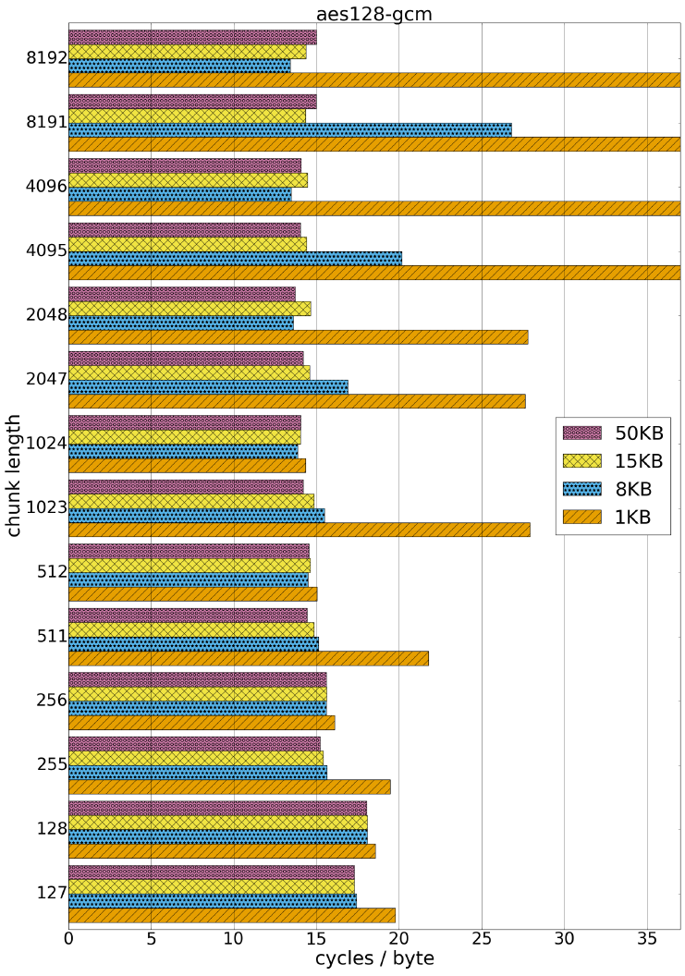
Encrypt
Decrypt
1.4-2.5 cycles / byte
14-27 cycles / byte
Constant-time padding removal
InterMAC with ChaCha20-Poly1305: 25-35$×$ slower
There is a lot of room for implementing optimisations
Notes:
We performed a quite extensive benchmarking of libInterMAC for various different message sizes.
The x-axis reports the performance in cycles/byte and the y-axis denotes the chunk length used.
This chart is for InterMAC encryption using aes-gcm as the internal nonce-based encryption scheme.
For our choice of message size, we see that we get best performance when the chunk length is closest to the message length.
And if discounting the measurements for the 1KB message, we achieve a performance around 1.4-2.4 cycles / byte.
For decryption our measurements are more negative.
Here we need 14-27 cycles / byte, again not counting the measurements for the 1KB message.
Hence, decryption seems roughly 10 times slower than encryption.
The main reason being that we use constant-time padding removal.
If we replace aes-gcm with chacha-poly as the internal nonce-based encryption scheme, InterMAC becomes between 25-30 times slower. So, obviously we performed these measurements on a machine with AES-NI…
However, we haven’t spent much time trying to optimise for speed, so there should be room for improvements.

Slide 16
InterMAC-based encryption scheme integration in OpenSSH
Required a number of modifications to OpenSSH:
SSH packet
Packet
Length
Pad
Len
Payload
Padding
4
1
≥4
Standalone code-path for encryption/decryption
InterMAC requires non-standard buffering of decrypted messages in OpenSSH layer
Makes integration complex
Notes:
We wanted to test how InterMAC performed in SSH using our library. To do this, we implemented InterMAC-based encryption schemes in OpenSSH one of the most popular implementations of SSH.
This required us to make a number of modifications to OpenSSH.
Firstly, we removed some fields from the SSH packet format, which also saves a tiny amount of bytes per packet.
We implement InterMAC in its own standalone code-path because it is conceptually different from other encryption schemes that are somewhat unified under the same code in OpenSSH.
InterMAC also requires different buffering from current encryption schemes, because we might decrypt several ciphertexts at a time.
In total, this makes integration of InterMAC in, at least OpenSSH, quite complex.

Slide 17
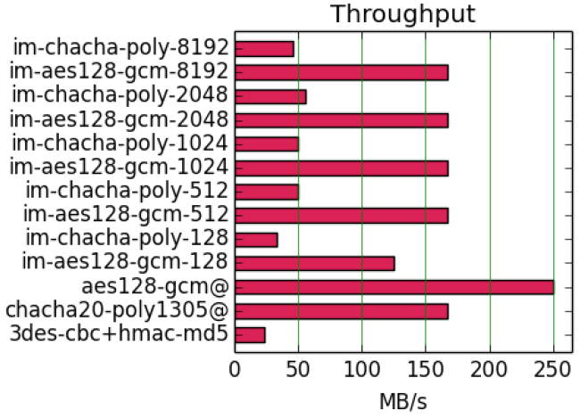
AWS London
Availability zone 1
SCP 50 MB
AWS London
Availability zone 2
Chunk
length
Internal
AE schemes
InterMAC-based
encryption
schemes
Current default
Notes:
The current default in OpenSSH is chacha20-poly1305 and the performance is equivalent to performance of intermac with aes-gcm.
However, none of the im cipher suites can compete with aes-gcm.
We clearly also observe that performance is computation-limited in this simulated lan environment.

Slide 18
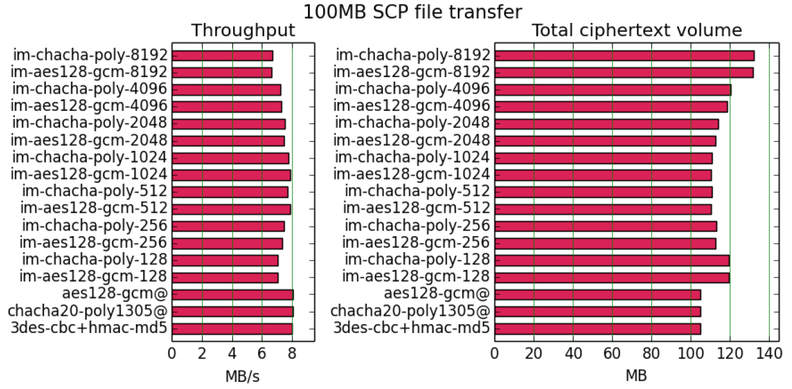
AWS London
region
SCP 100 MB
AWS Paris
region
10%-35%
N
N
N
Notes:
The situation changes when we switch to a simulated WAN environment.
We tried a few more different cipher suites and also send a bigger file.
Contrary to the first experiment, we observe that performance is not computation-limited but instead likely network-limited. This could either be saturation of bandwidth or different default values set by AWS in their networks. We did not investigate this any further.
The amount of ciphertext sent by the already existing OpenSSH cipher modes is almost uniform.
The story is very different for the intermac-based cipher modes, where the amount of ciphertext bytes not only growths a lot but follows a very different distribution.
The reason for this is the padding applied in the intermac scheme. This together with extra encoding and MAC tags, increases the amount of ciphertext bytes between 10-35% compared to existing cipher modes.
It seems that the better aligned the chunk length is with the data segments served by the SCP application to the packet processing code of OpenSSH, the less ciphertext expansion there is and the better the performance is.

Slide 19
RFC 4251
Can these security properties be realised simultaneously In SSH?
At what cost?
We presented libInterMAC
Increased complexity
We went beyond the formal
security model
Affects performance to
some extent
Performance impact tolerable depending on network environment
OpenSSH integration: SSH binary packet protocol done right
Notes:
Our conclusions.
We implemented InterMAC.
Were we implement additional counter measures beyond the formal model.
We also made an attempt to improve upon the SSH binary protocol.
Unfortunately, there is some measurable cost. Firstly, increased complexity in implementations and integrations.
This affects performance to some extent for encryption and to a larger extent for decryption.
However, as we saw with our OpenSSH experiments, this might be tolerable depending on the use-case.

Slide 20
https://github.com/himsen/libintermac
https://github.com/himsen/intermac-openssh-portable
1
2
3
Torben Hansen @n_tbh
Martin Albrecht @martinralbrecht
Kenny Paterson @kennyog

Slide 21
InterMAC
[BDPS12]
Achieves BH and DoS
“low overhead”
N
N
N
0
0
1
Enc
Enc
Enc
IND$-CPA
Chunk counter:
Message counter:
0
Mac
1
Mac
2
Mac
c
c
c
PRF

Slide 22
Decryption buffer allocation
N
N
N
0
0
1
1
t
A priori: no knowledge of how long underlying message is
(re)Allocation time proportional to size of underlying message
libInterMAC: Fixed-sized buffer

Slide 23
Boundary hiding (traffic analysis)
Encryption of length field
Random length padding
Encrypt-then-MAC
AES-GCM
Sequence
Number
Packet
Length
Pad
Len
Payload
Padding
4
4
1
≥4
Enc
Packet
Length
Ciphertext
MAC tag
Mac
Not possible to encrypt the length field
Traffic analysis becomes easier

Slide 24
Boundary hiding (traffic analysis)
ChaCha20-Poly1305
Sequence
Number
Packet
Length
Pad
Len
Payload
Padding
4
4
1
≥4
K₁
K₂
[SQN]₆₄,Blk=[0]₆₄
ChaCha20
[SQN]₆₄,Blk=[1]₆₄
ChaCha20
0²⁵⁶
C₁
C₂
MAC tag
K₂
[SQN]₆₄,Blk=[0]₆₄
ChaCha20
K_{poly}
Poly1305
Reintroduces encryption of length field
Doubles key-size
Can’t utilise AES intrinsics

Slide 25
Denial-of-Service
Encrypt-then-MAC
AES-GCM
Sequence
Number
Packet
Length
Pad
Len
Payload
Padding
4
4
1
≥4
Enc
Packet
Length
Ciphertext
MAC tag
Mac
Flip bit
Causes the receiver to hang, awaiting more data
Can also be performed on encrypted length fields – less reliable

